Slide 1


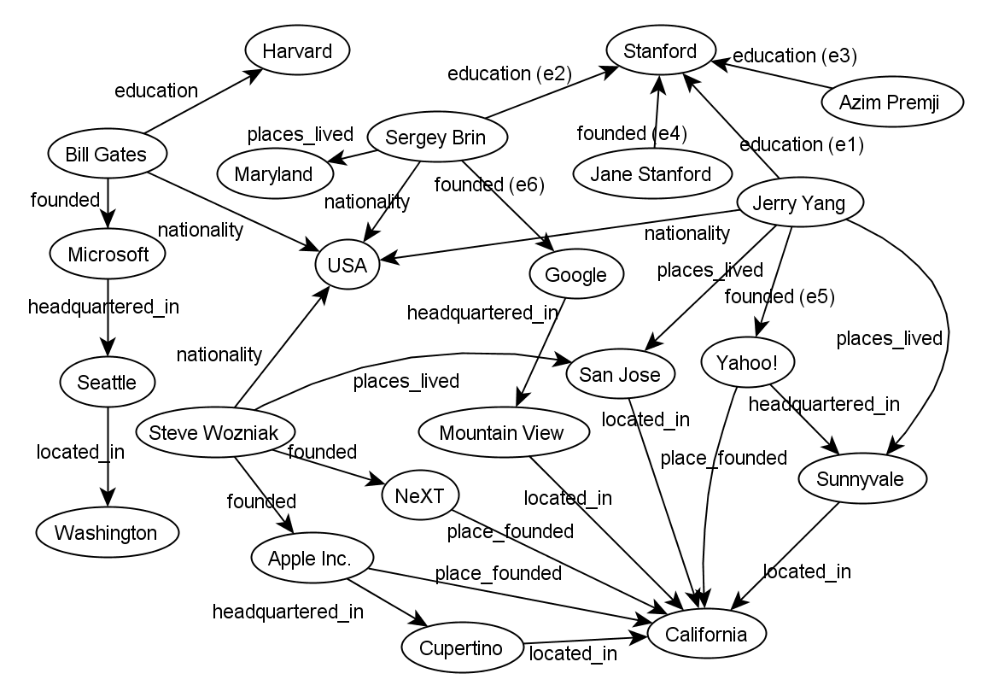
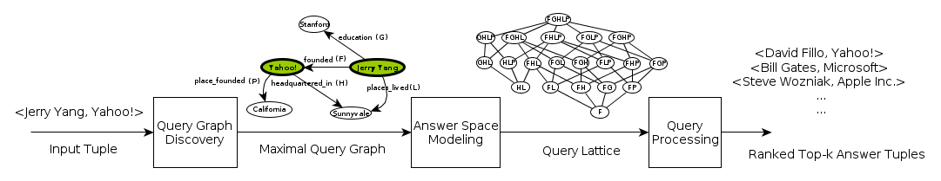
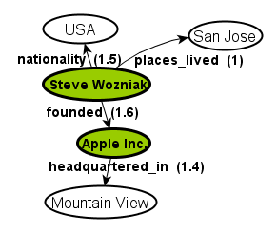
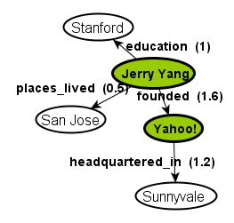
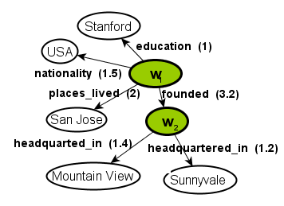
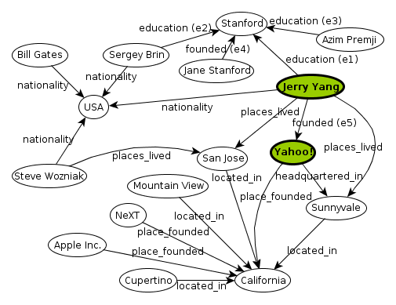
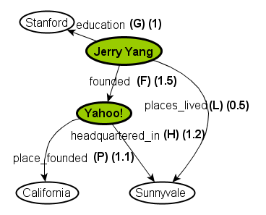
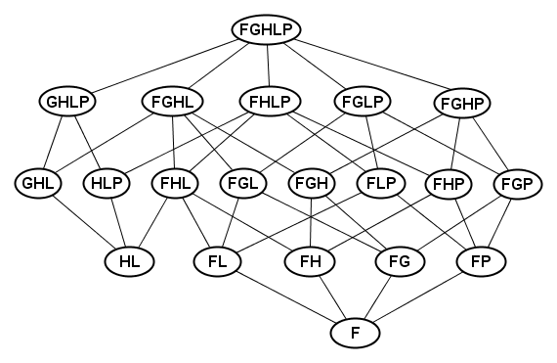
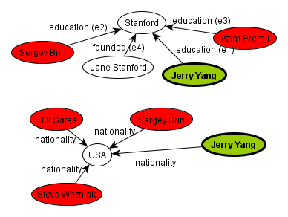
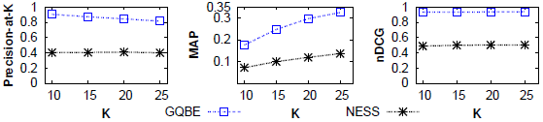
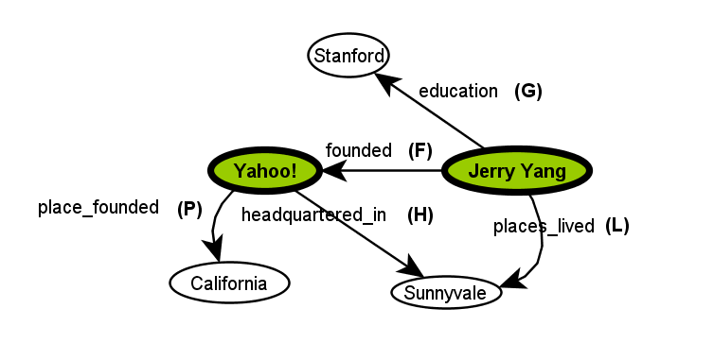
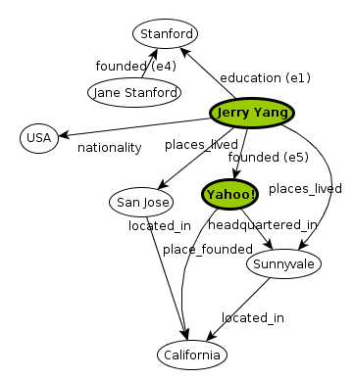
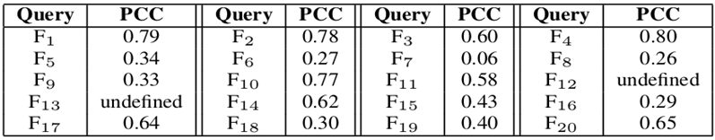
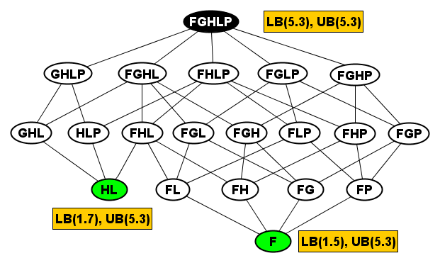
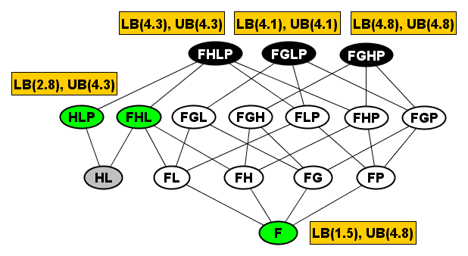
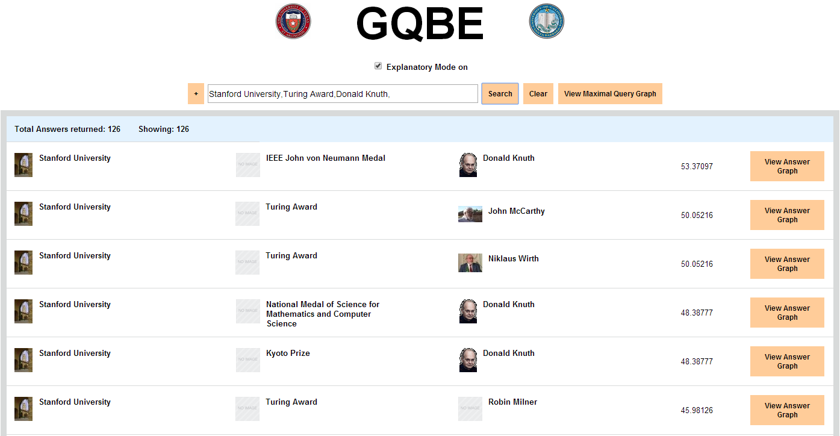
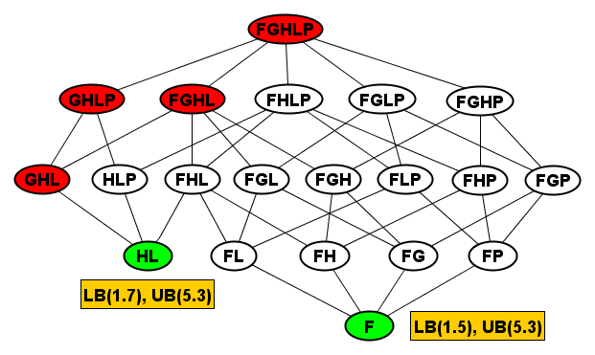
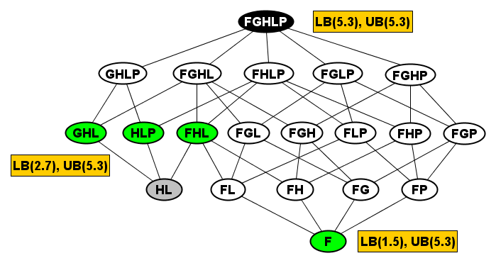



GQBE: Querying Knowledge Graphs by Example Entity Tuples
30th IEEE International Conference on Data Engineering, Chicago, IL, 2014
Nandish Jayaram ¹ , Mahesh Gupta ¹, Arijit Khan ², Chengkai Li ¹, Xifeng Yan ², Ramez Elmasri ¹
University of Texas at Arlington ¹ University of California, Santa Barbara²
Knowledge Graphs
GQBE Architecture
Multiple-Tuple Query Graphs
Input is an example tuple: an example of what the user wants to find.
Output is a set of similar answer tuples.
Multiple MQGs are merged based on edge labels and vertex label matches.
Weight of edges common to multiple query graphs is added. founded gets a weight of 3.2.
Steve Wozniak and Jerry Yang are merged into W₁ while Apple Inc. and Yahoo! to W₂.
Query Graph Discovery
Answer Space Modeling
Unimportant edges
Linking Open Data:
52 billion RDF triples
Freebase:
1.8 billion facts
Dbpedia:
470 million facts
Yago:
120 million facts
Experiments
Usability Challenges
Obtain neighborhood graph and remove unimportant edges.
Big and complex data.
- Lack of schema.
- Challenging to users (both novice and experienced) and developers.
How to query the graph, and understand the results.
Nodes (F) and (HL) are two minimal query trees.
Node (F) corresponds to the sub-graph that connects Jerry Yang and Yahoo through edge founded.
Node (FGHLP) is the MQG, and it corresponds to the entire query graph on the left.
Each internal node in the lattice is a sub-graph of the MQG.
Ground truth based accuracy comparison of GQBE and NESS. The measured parameters are precision-at-k, Mean Average Precision and normalized Discounted Cumulative Gain.
Weight edges using heuristics and use a greedy approach to obtain a smaller connected MQG.
Related Work
Query Processing
Pearson Correlation Coefficient (PCC) between GQBE and Amazon Mechanical Turk Workers, for k=30. MTurk workers were presented with answer pairs and asked for their preference between the two answers in each pair. The user preferred ranking was compared with GQBE’s ranking list. 20000 such opinions collected.
Query-by-example in relational databases [Zloof, 1975].
Keyword search and keyword-based query formulation [Chang et al., 2011].
Set expansion [Wang et al., 2007].
Semantic query by example [Lim et al., 2013].
XML query relaxation [Amer-Yahia et al., 2005].
Initial Lattice
Modified Lattice with Recomputed Upper Boundary
Search Interface
Upper Bound (UB) of a node is the score of its highest-scored super-graph in the lattice.
All the super-graphs of a null node are pruned.
Query processing times of GQBE, NESS and Baseline.
Technical Details and Demo
[1] N. Jayaram, A. Khan, C. Li, X. Yan and R. Elmasri. Querying knowledge graphs by example entity tuples, in arxiv.org/abs/1311.2100
[2] Demo URL: http://idir.uta.edu/gqbe
Lower Bound (LB) is the edge matching score of the corresponding graph.
(GHL), a node which does not have any answers, is a null node.

